Slide 1

-

Slide 2
DISEASES AND THE GLOBE
The spread of disease is dependent on where you are in the world.

Slide 3
Hygiene Standards in the Developed World e.g. Australia

Slide 4
-Laws around the quality of food produced/served
- Education on hygiene practices in schools and via advertisements/campaigns
-Clear guidelines showing expiry dates
-Penalties if these laws/process aren’t being upheld
Notes:
Blank out

Slide 5
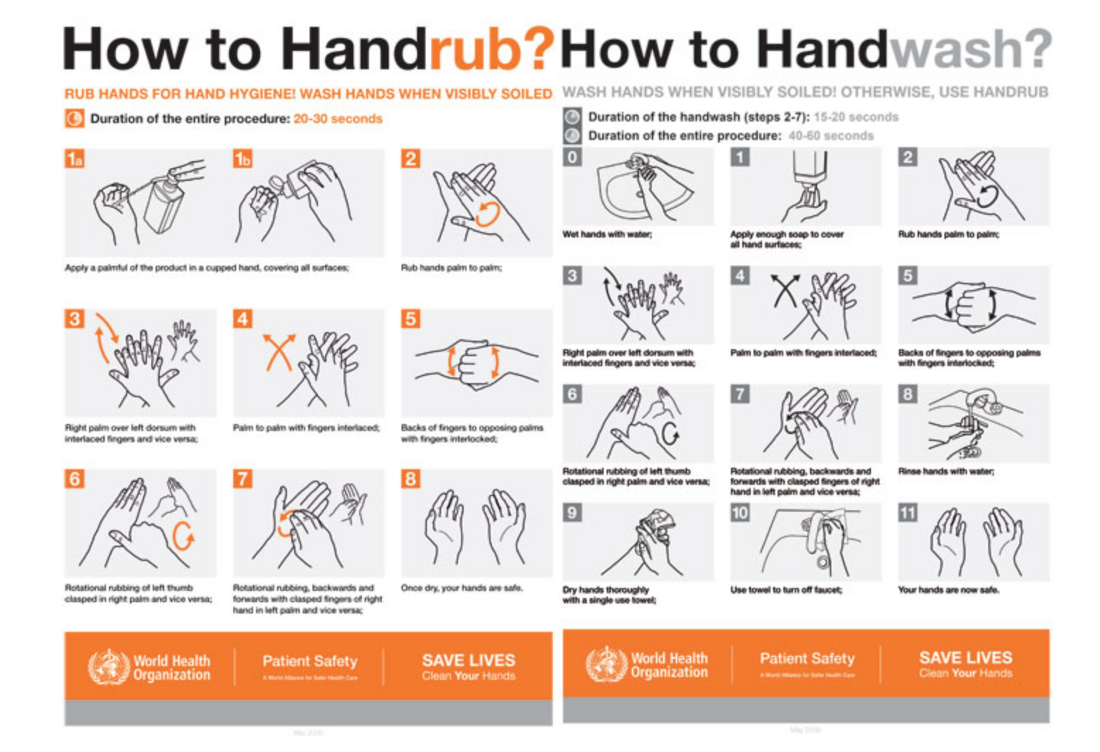
Robin Cochran-Dirksen (Many slides from BioEdOnline Baylor Christine Herrmann PhD)

Slide 6
Hygiene Standards
in the Under Developed World e.g. ?
CAN YOU GET 5 THINGS?

Slide 7
- Lack of government control/laws
- People are not educated on hygiene practices
- Need for food outweighs the time and preparation it takes to ensure it is hygienic
- Food is not sold in supermarkets but on the street from vendors
Notes:
Blank otu

Slide 8
SLOGAN
Create an advertisement slogan / song / rap / saying to promote hygiene practices
Pick your audience!
Robin Cochran-Dirksen (Many slides from BioEdOnline Baylor Christine Herrmann PhD)

Slide 9
IN BOOKS DRAW
Disease | Ethnicity | Description of disease

Slide 10
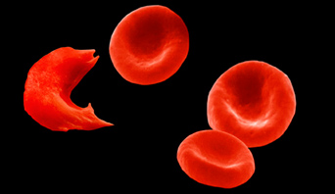
SICKLE CELL ANEMIA
Inherited genetic condition among those whose of African decent.
.

Slide 11
TAY-SACHS DISEASE
Inherited genetic condition found in the European Jewish population.
Notes:
infants with the disorder appear to develop normally for the first few months of life, then at about the age of six months of age, a deterioration of mental and physical abilities begins. the child stops smiling, crawling or turning over, loses their ability to grasp or reach out, and gradually becomes blind and paralysed. it affects both male and female babies.

Slide 12
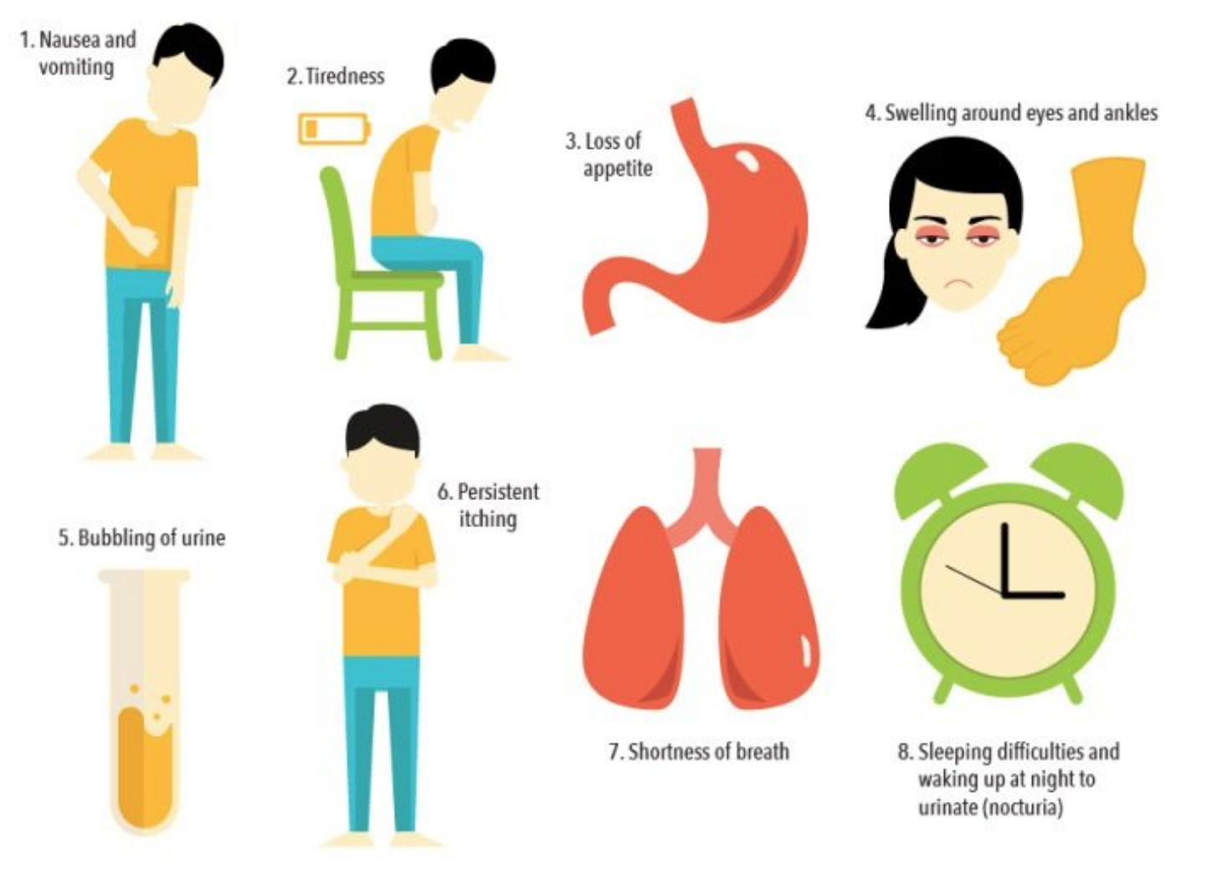
CHRONIC KIDNEY DISEASE
Indigenous Australians were found to be more likely to have chronic kidney disease (an lifestyle disease.)

Slide 13
COMMUNITIES AND DISEASE
Why do these ethnicities have higher chances of said diseases?

Slide 14
COMMUNITIES AND DISEASE
They have children with people of the same ethnicity. This way disease is often pass downed or habitats are passed on.

Slide 15
WHY ARE DISEASES SPREADING IN THE 21ST CENTURY?

Slide 16
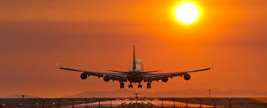
MOVEMENT OF PEOPLE
We are travelling more e.g. tourists and refugees.
This means diseases not seen in Australia are now coming to our shores.

Slide 17
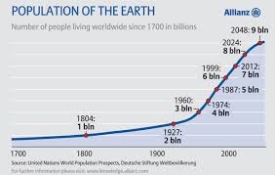

Slide 18
POPULATION GROWTH
More and more people in “small spaces.”
This means we have more contact with people which increases our chance to catch a disease.

Slide 19
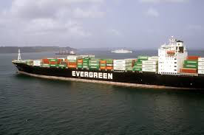
FOOD TRANSPORT
As products travel around the world there is an increase in foodborne illness as rats travel with products.
Rats often carry diseases.

Slide 20
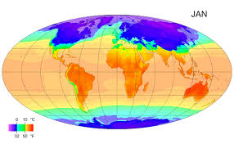
CLIMATE CHANGE
Climate change causing environments capable for diseases to spread as areas get hotter, more diseases occur e.g. malaria.

Slide 21
COMMUNITIES AND DISEASE
Certain ethnicities are more likely to get disease

